Slide 1

Communications Testing
An Amárach Research Briefing
May 2016
Strictly Private & Confidential

Slide 2
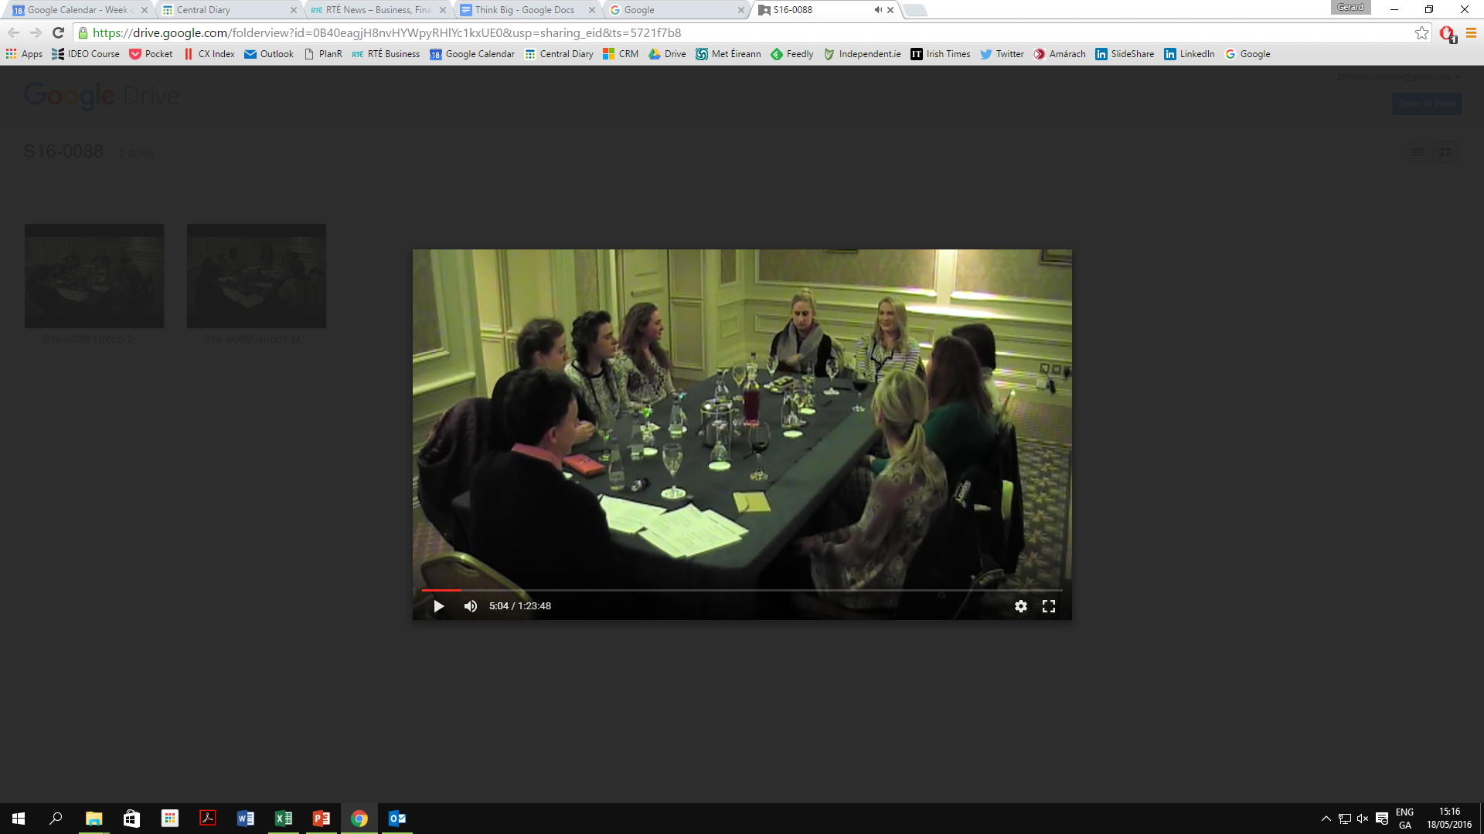

Methodology
This report summarises the outputs from four focus groups in April 2016 – 2 female groups in Cork and 2 male in Nenagh – exploring the impact of different messages on attitudes to abortion in general and the 8th Amendment in particular.
The groups were also divided into a younger group (20-25), and an older group (40-60).
Participants were recruited on the basis that they did not strongly support repeal of the 8th nor strongly oppose repeal either.
A separate spreadsheet summarising the written responses from all 32 respondents in their handouts has also been provided.

Slide 3
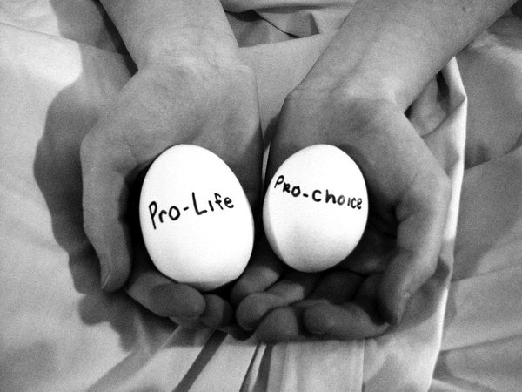
Current Attitudes

Slide 4
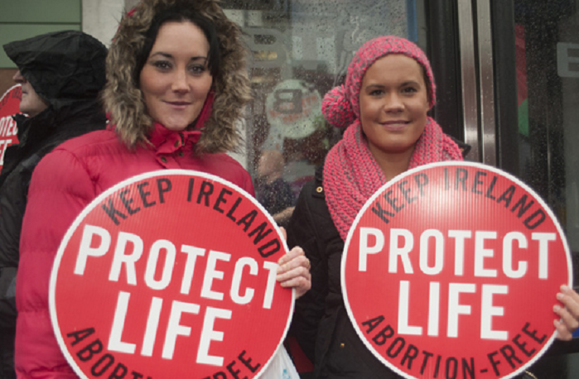
Current Attitudes – I
The debate about the 8th Amendment was not an important issue for most people in the recent General Election.
It isn’t a topic people feel comfortable discussing nor compelled to discuss – most political priorities centre on jobs, the economy, housing etc.
Most people are simply unaware of what the 8th Amendment states and what it means or intends, nor are they aware of prevailing medical practices and legal provisions in relation to medical interventions for pregnant women.
Most people (especially women) assume that Savita Halapannavar died because she was denied an abortion that would have saved her life.

Slide 5
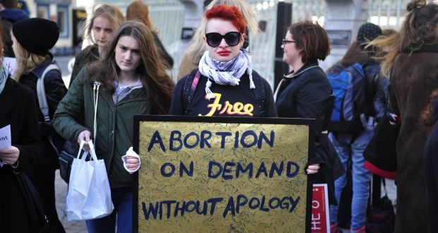
Current Attitudes – II
There was some indication of a more polarised attitude to the topic of abortion among younger people than among older people.
Older participants in the groups (especially men) seemed less willing to ‘take a stand’ one way or the other on the issue, whereas younger people were more divided and quite willing to disagree with others in the groups on the issue (both pro and anti repeal).
This suggests that any referendum on the 8th Amendment is unlikely to witness the same ‘uniform’ attitude among younger people that there was in the case with the marriage equality referendum in 2015.

Slide 6
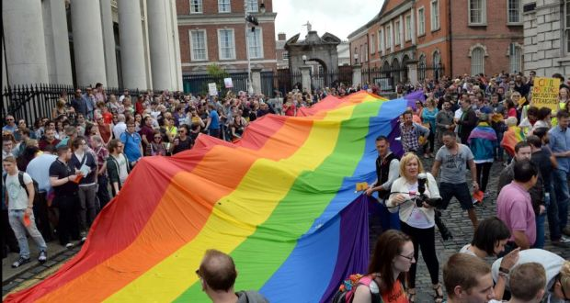
Current Attitudes – III
Though the marriage equality referendum is still very fresh in the memories of those who participated in the groups, there is no sense of ‘inevitability’ about a referendum to repeal the 8th being a foregone conclusion ‘just like’ 2015.
Not only are opinions less formed, abortion isn’t even seen by many has an ‘equivalent’ issue, i.e.: one merely about equality etc.
Instead, most feel that the issue of abortion simply doesn’t lend itself to simple ‘slogans’, and there are pervasive fears about the consequences of repeal of the 8th, even among those inclined to support repeal.

Slide 7
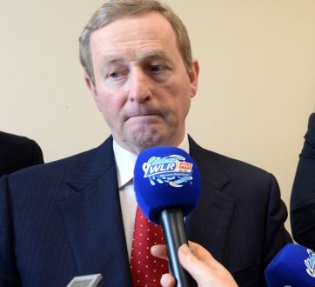
Current Attitudes – IV
A key requirement for all respondents in the event of a referendum on the 8th amendment would be clarity over what the government intends ‘doing next’ should it be repealed.
There is next to no trust in the ability of our politicians to legislate effectively and compassionately for changes to the laws on abortion, even if most voted to repeal the 8th.
Add in ‘complicating’ issues such as adoption, IVF, in vitro genetic screening as well as online access to abortifacient drugs (all of which came up in the groups) and it becomes clear that the entire issue could be a political minefield whichever way any government leans in the event of repeal.

Slide 8
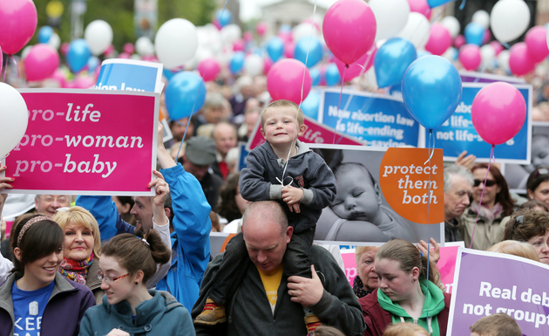
Abortion Messages

Slide 9
Messages
We tested 12 posters in all four groups (a mix of pro life/pro abortion messages), as well as two videos; while in the male groups in Nenagh, we added a 13th poster as well as an audio file for testing.
The testing followed the same format – each participant was given a handout, and they were asked to write down their reactions to each poster as it was passed around, as well as to the video/audio content.
They were asked firstly to say what was most convincing about the message (whether they agreed with it or not); what feelings or emotions it evoked; whether they thought it might persuade others who are undecided on the issue; and what effect if any it had on their own attitudes towards the 8th amendment – as illustrated opposite.
The following slides summarise responses.

Slide 10
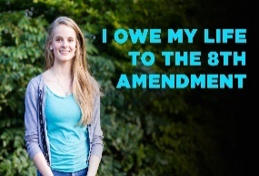
Image 1
Having an image of a young woman, who could be a young mother herself, is quite powerful.
The message doesn’t need too much analysis or interpretation.
It seemed to resonate more with younger men and women than older adults.
Convincing | A clear message of ‘survival’
Feelings | Happy, positive feelings – “she’s alive because of 8th”
Influence others? | Yes: 18 out of 32
Vote Effect | 0 for females (so neutral); +2 for males (more inclined to keep 8th); net +1

Slide 11

Image 2
This was slightly more polarising: those inclined to repeal ‘doubt the number’.
It’s generally quite hard for people to grasp large numbers: so they either reject them or over-analyse them and miss the point, but faces make it more ‘real’.
One option might be to state it more in terms of ‘the population of Waterford’ or something more tangible/comprehensible.
Convincing | Reminder of potential ‘scale’ of abortion, but abstract
Feelings | Certain amount of shock, even gratitude for 8th
Influence others? | Yes: 17 out of 32
Vote Effect | 0 for females (so neutral); +2 for males (more inclined to keep 8th); net +1

Slide 12
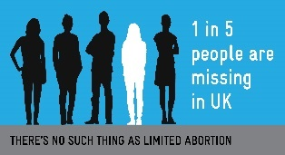
Image 3
Like the previous poster, this shocked many people, with several noting that it showed what ‘unlimited abortion’ might mean.
Some tended to personalise their reaction: it could be my brother/cousin/niece – with the ’odds’ worse than Russian roulette.
The poster surfaced a lot of concern about Ireland not ‘becoming just like England’, as they realise scale of abortion there.
Convincing | Another reminder of potential ‘scale’ of abortion, but needs more explaining
Feelings | Again a certain amount of shock, but relevance not clear
Influence others? | Yes: 18 out of 32
Vote Effect | 0 for females (so neutral); +1 for males (more inclined to keep 8th); net +1

Slide 13
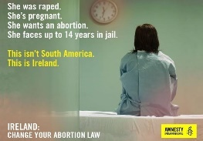
Image 4
This image was one of the most effective for the pro-choice campaign, highlighting the loneliness and vulnerability of Irish women dealing with abortion.
Few of the pro-choice posters show the mother, and this finding prompted Image 13 for the Nenagh groups.
Both men and women were moved by this poster towards repeal of the 8th.
Convincing | Sense of loneliness of woman, not supported at home
Feelings | Shame, feel sorry for woman, sense of pity
Influence others? | Yes: 17 out of 32
Vote Effect | -2 for females (so more inclined to repeal); -2 for males; net -2

Slide 14
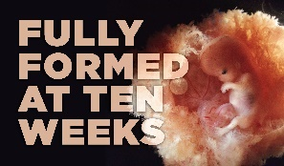
Image 5
Women in particular found this poster affecting, with younger ones in particular remarking on the level of development.
Those more inclined to repeal tended to doubt the image or statistic, which suggests that such imagery won’t ‘convert’ repealers.
Nevertheless, men found the image effective in bringing the baby into the conversation about abortion.
Convincing | Women especially surprised at development at 10 weeks
Feelings | Desire to protect the baby, though others doubt ‘statistic’
Influence others? | Yes: 14 out of 32
Vote Effect | +2 for females (more inclined to keep 8th); +1 for males; net +1

Slide 15
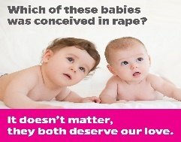
Image 6
Rape in relation to the abortion debate is an extremely sensitive issue.
Women were much more likely to reject the argument in the poster, while men were more open to it.
Indeed, some women saw the poster as ‘emotional blackmail’ and somewhat misogynistic in the context of rape.
Convincing | For some a reminder that the child isn’t guilty of an adult’s crimes, for others a callous attitude to women
Feelings | A mix of anger for some, compassion for others
Influence others? | Yes: 14 out of 32
Vote Effect | -1 for females; +1 for males (more inclined to keep 8th); net 0

Slide 16
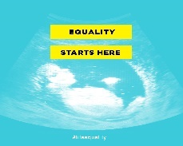
Image 7
This was the least convincing of the posters we tested for men and women.
Though most get the point, many find it unconvincing in terms of the wider debate.
Like Image 5, it is good to remind people of the human life ‘inside’, but the overall portrayal of the message leaves many cold in terms of its communications impact.
Convincing | A sense of the helplessness of the baby, but seen as a quite abstract argument
Feelings | A general lack of clarity about the point being made
Influence others? | Yes: 8 out of 32
Vote Effect | +1 for females; +1 for males (more inclined to keep 8th); net +1

Slide 17
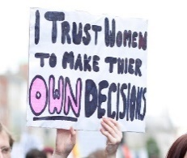
Image 8
This resonated with many women with its focus on the woman’s agency in the decision to have an abortion.
Similarly it left many men feeling that they should ‘shut up’ as it’s a woman’s choice.
That said, several women as well as men rejected the implication that one person on their own can make such an important, life-changing/terminating decision.
Convincing | Talks to the core issue of choice & control for women
Feelings | Recognition of women’s rights, but rejection by some men that they’ve ‘no say’ in the matter
Influence others? | Yes: 14 out of 32
Vote Effect | -2 for females (more inclined to repeal); 0 for males; net -1

Slide 18
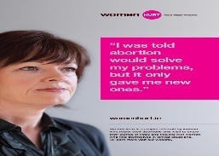
Image 9
This poster resonated with both men and women, young and old.
By having a ‘real woman’ talking about her experience and regrets it brings home the consequences of decisions that may not be apparent at the time.
It also highlights the issue of support for women going through or who have gone through crisis pregnancies.
Convincing | A key word that came through is ‘regret’
Feelings | That women need support and to feel abandoned
Influence others? | Yes: 16 out of 32
Vote Effect | 0 for females (so neutral); +2 for males (more inclined to keep 8th); net +1

Slide 19
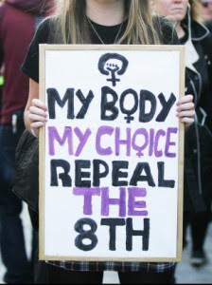
Image 10
Like Image 8, this resonated more strongly with women than men, highlighting the crucial theme of ‘choice’ and control.
The apparent youthfulness of the woman holding the poster is also a reminder that the issue especially affects younger women.
Again, some of the men – also younger ones – felt they were being deliberately excluded from the debate, whether as fathers or partners.
Convincing | Appeals to core feminist message of choice, but it excludes both the baby and father from the conversation
Feelings | Quite alienating for some men & women: too ’absolutist’
Influence others? | Yes: 11 out of 32
Vote Effect | -2 for females (more inclined to repeal); 0 for males; net -1

Slide 20
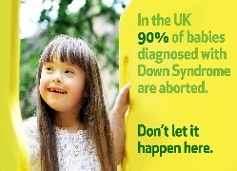
Image 11
This the most compelling pro-life message tested in all four groups.
Indeed it was the most convincing poster for the women groups (young and old), with many expressing shock and sadness at the statistic for the UK.
The poster surfaces the key issue of ‘why it’s okay to abort some babies’ but not others, as well as showcasing the extremities to which abortion can lead.
Convincing | Very convincing, with many expressing shock at number
Feelings | Many said they found the statistic ‘saddening’
Influence others? | Yes: 20 out of 32
Vote Effect | +2 for females (more inclined to keep 8th); +1 for males (also more inclined to keep 8th); net +2

Slide 21
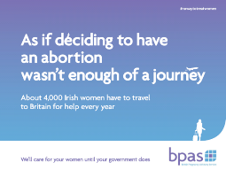
Image 12
This was considered the most convincing of all the repeal/pro-choice posters; especially for women.
Despite not having any imagery, it again evokes a sense of empathy with women facing the situation ‘alone’, and shame at Ireland’s ’dumping’ its problem on the UK.
Again the statistic shocked many, whether inclined to retain or repeal the 8th.
Convincing | Sense of ‘we should solve our own problems’, sympathy for women affected
Feelings | Anger for many, empathy for women making the trip
Influence others? | Yes: 21 out of 32
Vote Effect | -3 for females (more inclined to repeal); 0 for males; net -1

Slide 22
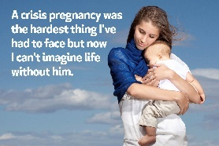
Image 13
This poster was only tested in Nenagh, having been created in response to the issue of empathy for women noted in the Cork groups.
Also the poster recognised the difficulty of the decision while highlighting the lack of regret at not having an abortion.
It was received extremely positively by both the young and older men in the groups.
Convincing | The love of a mother for her son after all the stress
Feelings | Relief and happiness at her own happiness
Influence others? | Yes: 10 out of 16
Vote Effect | +2 for males (more inclined to keep 8th)

Slide 23
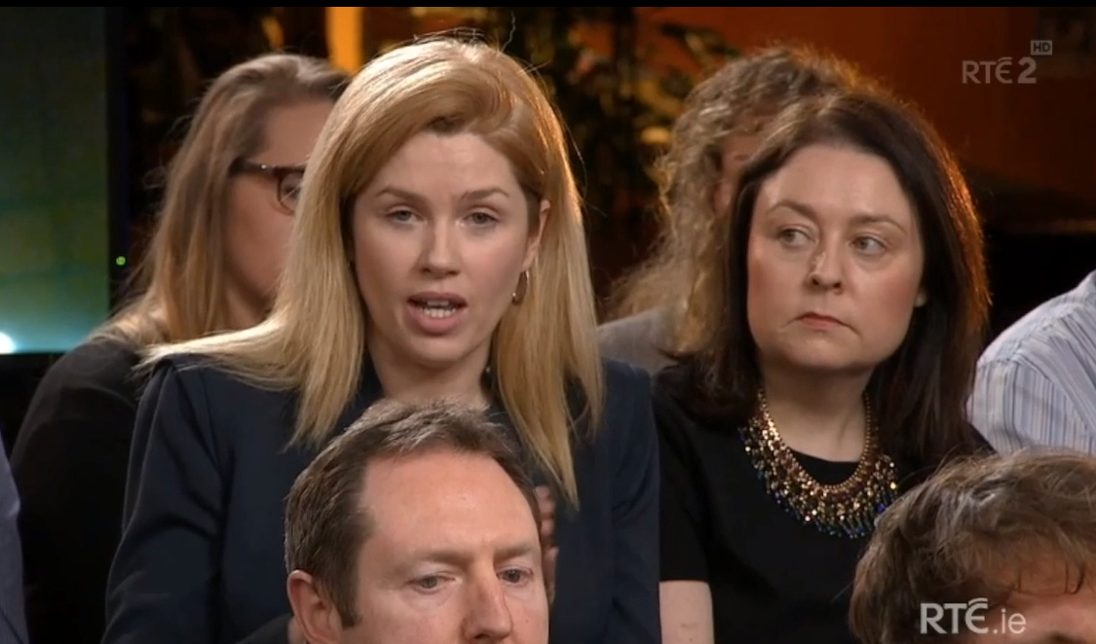
Video 1
Most (though not all) found the message about 24 weeks quite shocking, and found link between equality and rights convincing.
Also highlights how abortion isn’t a ‘black & white’ issue – lots of grey areas inevitable even if 8th repealed.
Raises issues of guidelines, legislation and regulations in relation to abortion: not simply a matter of repeal.
Convincing | Equal rights for children, prospect of greater inequality
Feelings | Sense of uncertainty even if 8th repealed
Influence others? | Yes: 17 out of 32
Vote Effect | 0 for females (so neutral); +2 for males (more inclined to keep 8th); net +1

Slide 24
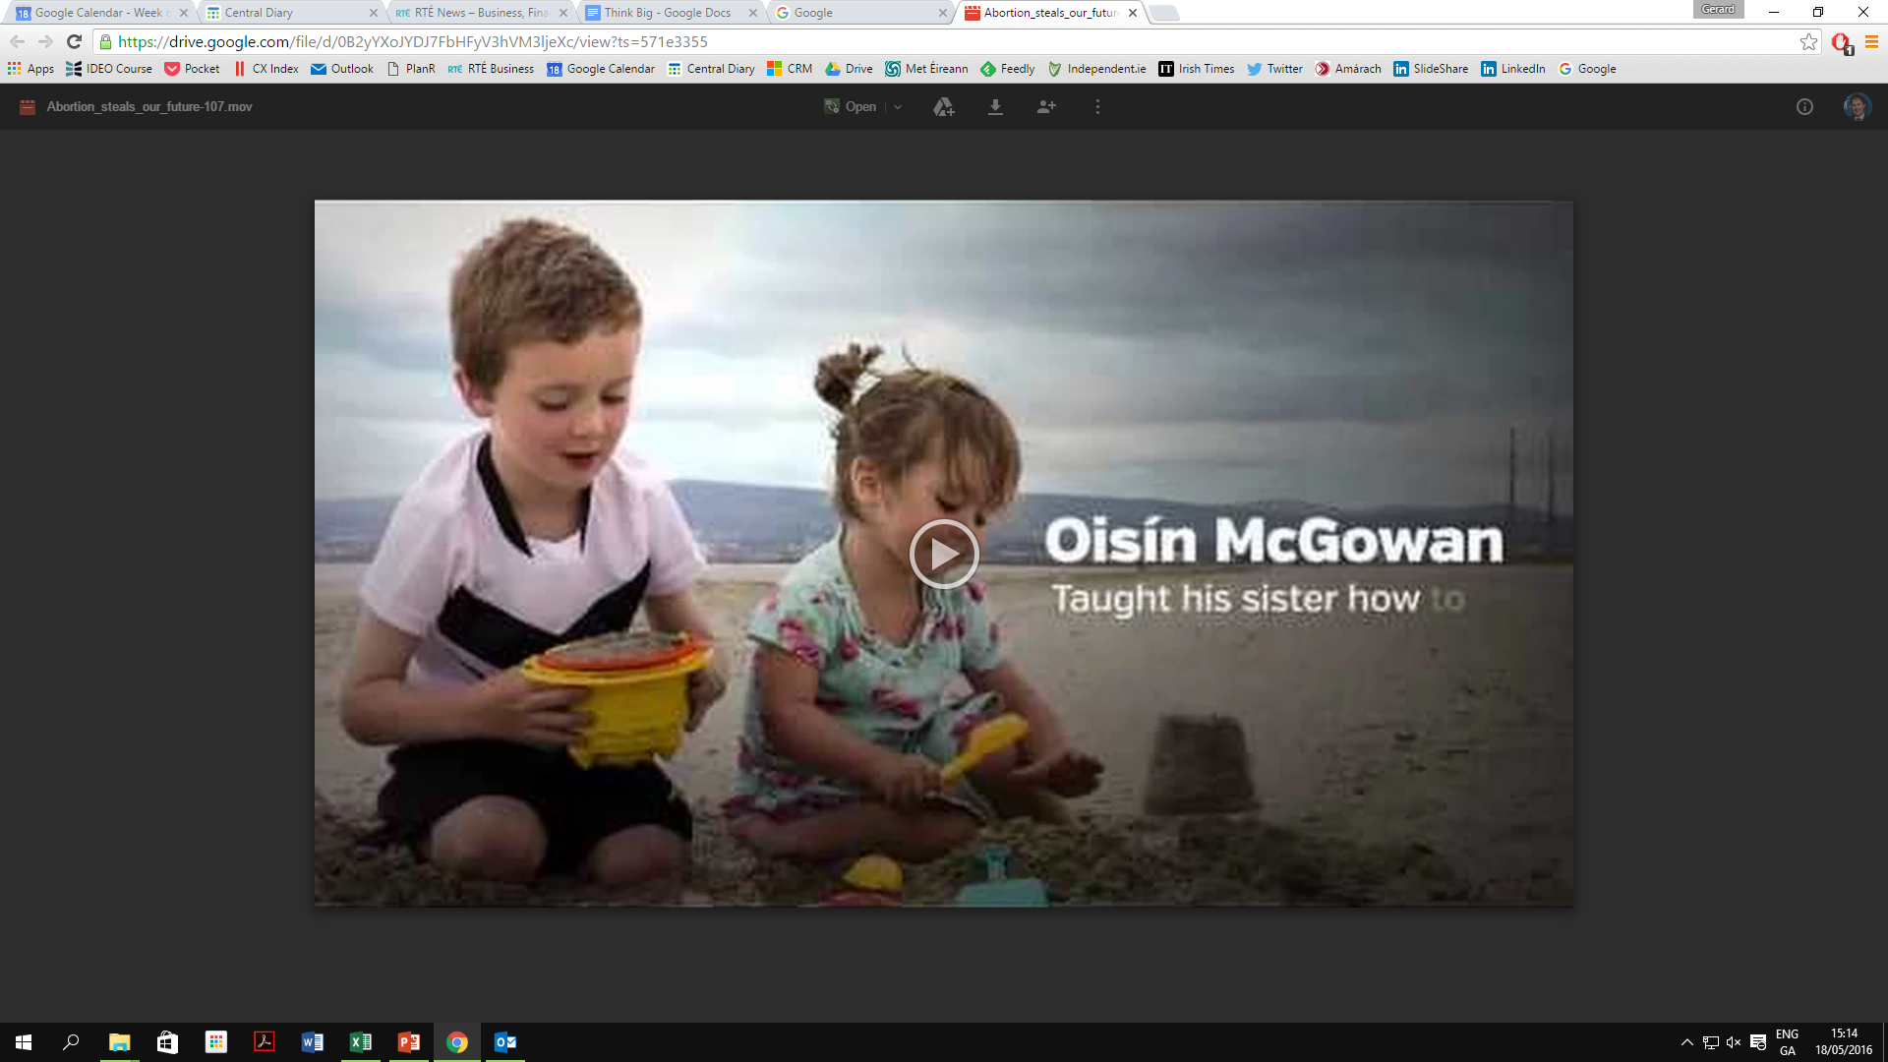
Video 2
This video had a more polarising effect: the women in the groups weren’t especially moved by it (some were even angry at being ‘manipulated’) while the men were positive.
Nevertheless, both men and women easily grasped the message– that abortion steals the future from the children it affects – and many found this quite moving.
Despite the reservations of some of the women (who rejected it) it scored very highly in likelihood to influence others.
Convincing | A sense of what is missed/stolen by abortion
Feelings | Sense of regret, sadness and the personal impact
Influence others? | Yes: 21 out of 32
Vote Effect | -1 for females (more inclined to repeal 8th); +2 for males (more inclined to keep 8th); net +1

Slide 25
Audio 1
We played one audio, and only in Nenagh, dealing with the issue of a pregnant woman getting an abortion when told her baby has a life limiting illness.
Most men found the audio recording – with the woman describing her experience – as quite sad and deserving of sympathy.
It was felt to be an issue that the woman should have been able to resolve in Ireland without having to go to the UK.
Audio
Convincing | Sense of shame that Irish health service couldn’t help
Feelings | Sadness at the situation she faced and impact it had
Influence others? | Yes: 10 out of 16
Vote Effect | -2 for males (more inclined to repeal 8th)

Slide 26
Additional Messages
In addition to the posters, videos and audio testing, we presented participants in the groups with different statements to gauge their impact on their attitudes to the 8th amendment (same scale ranging from -5 to 0 to +5).
The mean scores are summarised overleaf: though there are consistent differences between men and women, one statement – regarding the ‘slippery slope’ in relation to relaxing abortion standards – was convincing to both, causing both to lean retention of the 8th.
We also presented the groups (time permitting) with three different ‘crisis pregnancy’ scenarios to see what language/arguments women and men might use in each situation.
We have created word clouds for the responses to each scenario – the verbatim responses are in the appendix.

Slide 27
Statements: Impact on Vote on 8th Amendment
1. “Abortion raises important issues about human rights, including the rights of the unborn baby.”
2. “Doctors in Ireland already intervene to save the mother’s life even if it results in the unintentional death of an unborn baby, even with the 8th amendment in the constitution.”
All | Women | Men
+1 | +1 | +2
All | Women | Men
0 | -1 | +1
3. “Many countries that permitted abortion on strictly medical grounds have ended up with widespread abortion on demand.”
4. “Abortion is an equality issue just like gay marriage, only it is about the equal right to life.”
All | Women | Men
+1 | +1 | +2
All | Women | Men
0 | -1 | +2

Slide 28
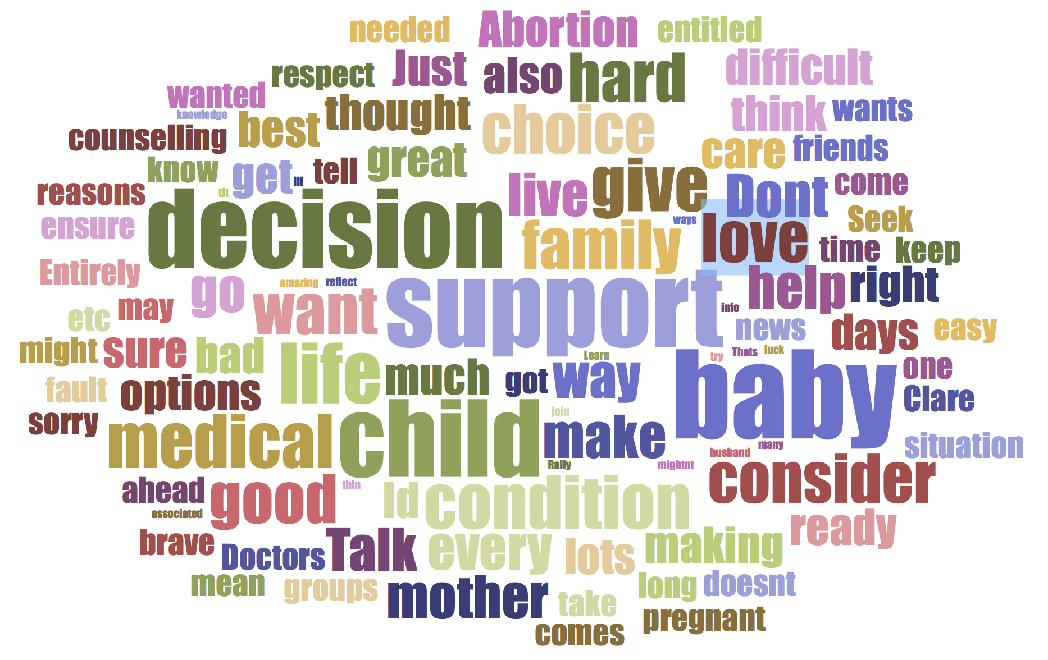
Scenario 1
“Claire is in her mid-30s, and has received fertility treatment to help get pregnant, but she has learned that her baby will be born with a serious medical condition and doesn’t know what to do. What advice would you give her?”
See detailed responses in Appendix

Slide 29
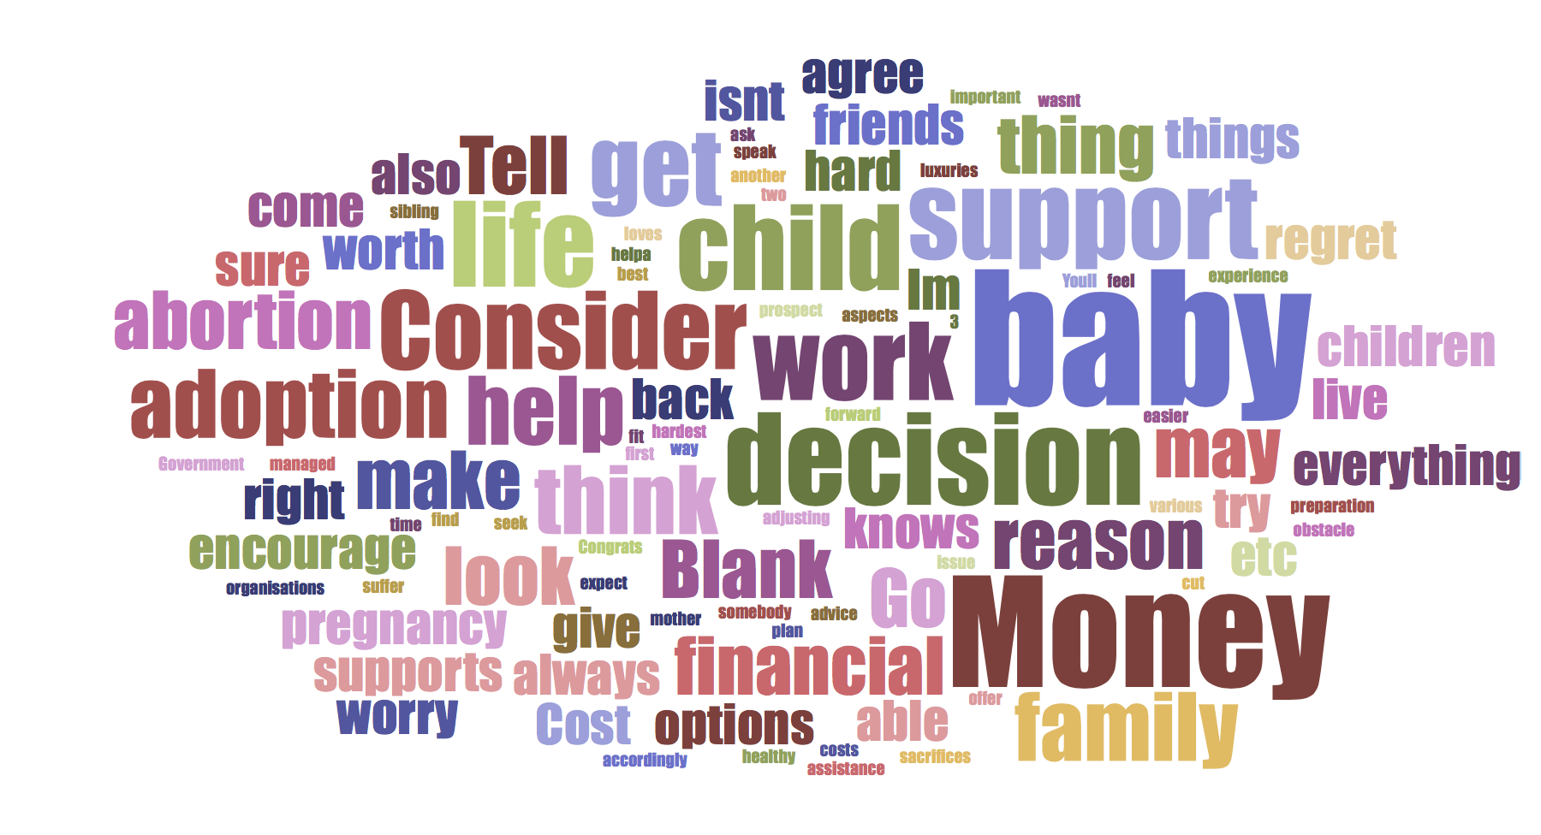
Scenario 2
“Jane is in her late 30s and has two children already. She finds herself pregnant, worried about the cost of a third child and doesn’t know what to do. What advice would you give her?”
See detailed responses in Appendix

Slide 30
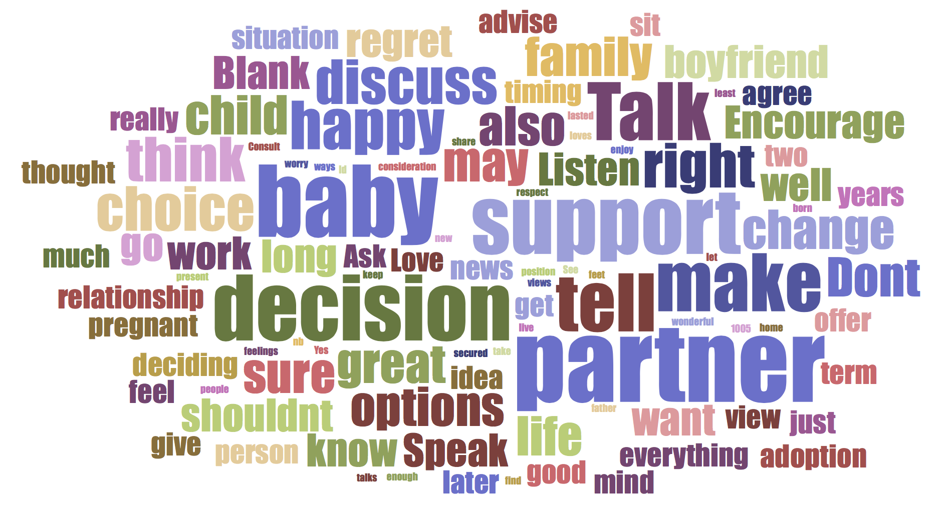
Scenario 3
“Sarah is in her mid-20s, not married but in a long term relationship. She finds herself pregnant, worried about her partner’s reaction and doesn’t know what to do. What advice would you give her?”
See detailed responses in Appendix

Slide 31

Implications

Slide 32
Conclusions – I
We added a number of questions to our May omnibus (nationally representative, online sample of 1,000 adults) to explore a few of the themes raised in the focus groups – these are summarised in the following slides:

Slide 33
Conclusions – II
We also explored attitudes to abortion in different scenarios:

Slide 34
Conclusions – III
A number of key messages emerge from this research:
Almost everyone is ‘open to persuasion’ on the issue of repealing the 8th Amendment: even those whose ‘default’ opinion is to support repeal
Nobody trusts the Government to address the legislation after a referendum: they want to know what the details will be before they vote
Nobody wants an ‘abortion on demand’ situation like in England, and most are genuinely disturbed by the scale of abortion in the UK (in total and specifically in relation to children with disabilities such as Downs Syndrome)
There is no obvious ‘fault line’ in relation to sides in the 8th debate, if anything younger men and women are more willing to engage strongly on the issue whereas older groups – especially men – are more reluctant to take sides.

Slide 35
Conclusions – IV
Effective, pro-life messages therefore need to:
Show compassion and empathy for the mother as well as asserting the right to life of the child
Remind people what the 8th does and doesn’t imply and how it manifests itself in caring medical practice
Keep the slippery slope issue to the fore especially in relation to England: what is meant to be ’safe and rare’ soon becomes ‘standard and common practice’
Reframe the conversation from the ‘crisis’ in ‘crisis pregnancy’ to one about avoiding regrets and providing caring and supportive resources for mothers-to-be
Celebrate the bravery of those mums who have their children rather than taking what might seem the only/easy option but that rarely is in hindsight
Get young men on board: they need the words, messages and support to help retain the 8th

Slide 36


e. info@amarach.com
w. www.amarach.com
b. www.amarach.com/blog
t. twitter.com/AmarachResearch

Slide 37
Appendix
Scenarios Details

Slide 38
Scenario 1: Claire is in her mid-30s, and has received fertility treatment to help get pregnant, but she has learned that her baby will be born with a serious medical condition and doesn’t know what to do. What advice would you give her? A) If she wanted to have the baby
Talk to the Doctors, friends, family, husband. I would support her and try to get as much info as she can about the condition.
That’s great news, it mightn't be as bad you thin, you would have great support. Ill do all I can to help.
I'd say, I respect your choice and I know you have thought long and hard and I will be there for you.
Take time to reflect 'Love' comes in many ways, Seek support and knowledge on condition of child.
Rally family and friends. Give all help needed. Support for her. Learn about tit - join groups associated with it. Love is love.
Best of luck - amazing medical resources and successes in Ireland. Baby will et best of care. Love and prayers will work. Often when baby is born not as bad as first thought. Stay hopeful.
Support her in every way needed, talk through with her and discuss what kind of a life the baby would have how long would it live for, what amount of pain on a daily basis the child would be in - but in no way tell her what her decision should be.
That she is very brave and that she will get lots of support but she should be aware that the baby may not survive.
It is entirely her decision, to consider all of her options before making a decision that she cannot undo. Having invested so much money and exhausting all of the options that she should go ahead with it.
I would say - you have come so far, there are a number of supports out there and you can do this.
She has wanted this to the point of paying to have the child. One child is a blessing, no matter what the condition
And you should give that baby the happiest life.
I would agree with her keeping the baby and ensure baby got necessary care.
Have the baby - congratulations.
Clare desperately wants to be a mother considering she got fertility treatment. She should have baby, as being a mother includes looking after child during the good days and bad.
I would support her - a child is a child regardless of medical conditions - you have a responsibility to the child.
To be sure about her decision and be ready with good support. To consult with her family as they will have to deal with the situation also.
Have the baby, love the baby.
To keep strong - there is plenty of support services in this country to support the baby.
I would support her decision as it's something she wants, just because its not perfect doesn't mean it won't make her happy.
Doctors can do great things nowadays and there may be a way for the baby to live a relatively good life.
If you want the baby be prepared to be ready with what comes with it e.g. hospital … care for the whole of child. Would you like to put you child through all the hardship of sickness.
I would advise her to have the baby, every baby is entitled to life but at the end of the day.
That if she want to a baby that the child will be sick and to remember that and will always have the problem.
Have the baby.
Go ahead with the pregnancy, there is lots of help out there after the birth of your child, lots of support groups etc.
I think she should be allowed to have baby when there is help there for her.
Not to have it.
Don't have the baby.
It would be totally up to herself, hard to call, probably have an abortion.
Encourage her to have the baby.
I will support you through all pregnant period in every way.

Slide 39
Scenario 1: Claire is in her mid-30s, and has received fertility treatment to help get pregnant, but she has learned that her baby will be born with a serious medical condition and doesn’t know what to do. What advice would you give her? B) If she didn’t wanted to have the baby
I would totally support her.
Its terrible news, do what's best for you, think of your future, you might have to give up your job/life etc.
Again, I'd say, I respect your choice it was not an easy decision, and will be there for you when you need me.
Seek options, counselling before making final choice - Accept your decision and move on.
Are you ready able for baby. Don’t feel guilty about decision. Not your fault. Prepare for aftermath.
So sorry for you, not an easy decision. The sorry and guilt will be heart-breaking for you, lack of support for mother IVF so difficult.
Again support her, tell her she's doing the right thing, make sure counselling is available.
I would understand this decision but she will have to live with this forever.
Entirely her decision and to seriously consider the life changing decision.
It is okay to not want to face this challenge. Would you consider adoption or an abortion?
Just because it's hard doesn't mean it will be impossible, the hard days will come but will make you all the more grateful for the good days.
If she felt it would be too difficult - I would allow her to make her own choice in this case -Medical condition.
I would also give reasons to keep the baby despite medical condition. It also depends on the live span of baby due to medical condition.
Don't have it, if you do not think you can handle it. I'm sure you’ve thought about it so much, I know it is a difficult decision.
Clare should reconsider as a medical fault should not stave her off being a mother.
The child has a right.
I would support her decision and ensure she has the right advice …
It would be her choice - I would support her - To talk it over with other family members.
Just to take serious time to consider the situation before making a decision she might regret for the rest of her life.
I'd repeat the above statement but support her in her decision if after all consideration its what she clear headedly wanted to do.
Maybe there could be a cure or new solution to the disease that the child has later in life.
I would support her as it is her decision but I would still give her my opinion of how the child is entitled to life.
That she has the option to go and adopt is she did not want to have one of her own.
Abortion - she is her own boss.
You are a brave courageous woman to go decide what you want.
I would disagree, she tried so hard to get pregnant and her family should stand by her.
Nothing.
Don't have the baby for health reasons.
Talk to her.
Please consider give you child to be every chance reward, will be good, you will see.

Slide 40
Scenario 2: Jane is in her late 30s and has two children already. She finds herself pregnant, worried about the cost of a third child and doesn’t know what to do. What advice would you give her?
A) If she wanted to have the baby
She knows best and has the experience to go forward with the pregnancy. The prospect of a sibling for her children.
You will find the money, There are financial supports out there, you could cut back on various luxuries in preparation.
You managed with two, another will fit in easier, The hardest thing is adjusting to the first. This time she knows what to expect and can plan accordingly.
You'll make it work.
I would say not to worry as there is always help/a way to look after baby. A healthy baby is more important than money.
Congrats! It will be hard work, but worth it I'm sure.
cost should not be any issue. Other aspects of life may suffer sacrifices but if she loves being a mother, they will make do.
Encourage her to speak to somebody about financial assistance - offer her financial support - ask her how she would feel about having a baby if money wasn't an obstacle.
To have the baby and seek help and advice from Government and other organisations who can help with the costs, also to consider adoption.
Suck it up and get on with it. The baby will being happiness and she won't be able to imagine life without baby when it is born.
She would have a lovely family ( 3 kids) Try to get support from family and friends - get support for services.
I think she should have the baby, money is not everything, she'll just have to adjust her lifestyle.
Cost of a baby isn't a huge deal. Things generally work out by themselves overtime.
Not to worry about money, it doesn't matter in life's large scheme of things.
I would totally agree with her there is lots of support out there.
That there will always be help out there for a parent, friend etc.
Have the baby, baby has the right to live.
Go and have the baby, you will regret having an abortion.
Go ahead with the pregnancy.
Have the baby.
To have the baby, life is precious.
Have the baby because it will work out.
Jane, look where you can get support and help from family, friends.

Slide 41
Scenario 2: Jane is in her late 30s and has two children already. She finds herself pregnant, worried about the cost of a third child and doesn’t know what to do. What advice would you give her?
B) If she didn’t wanted to have the baby
Its her decision but to seriously consider her options before she makes a decision that she may regret.
Would you be able to part with this baby? Give it up or have an abortion? If so they are your options, if not have a look at other supports
Money is not a reason to get rid of a child that will be loved.
You cannot do that - not a legitimate reason to have an abortion.
I wouldn't agree with decision, there is no medical reason not to keep baby.
I'm sure you didn’t come to this decision lightly - do what you have to do.
Jen needs to consider her entire family and think about how this baby may affect them. However. This child could be worth so much more to then the money saved not having it.
Convince her otherwise.
That she could consider adoption and if she can live with the decision.
She could put the child up for adoption - also maintain close contact with the child.
I think not to have it as a result of money would be the biggest mistake of her life.
I'd repeat the above statement - but support her decision if after all considerations that's what she wants.
That at end of day money isn't everything, the right to life outweighs this.
I would tell her to think long and hard about it, I would suggest adoption and I would tell her it was her own decision and I can't make up her mind for her.
To still have the baby, don't kill a living thing, it will all be ok
Have the baby and try save money on household bills etc. thing about going back to work.
That is your call and your business.
Money should not come in … Never saw a child die of the hunger.
I would say good.
Tell her to have it, encourage her through it.
Consider others who cannot have children and give child option for life.

Slide 42
Scenario 3: Sarah is in her mid-20s, not married but in a long term relationship. She finds herself pregnant, worried about her partner’s reaction and doesn’t know what to do. What advice would you give her? A) If she wanted to have the baby
Talk to her partner about this he may love the idea he also has a choice. I would listen to her but also respect her choice.
Have the baby, your in a great position, there is great support out there, you are very well secured.
I'd tell her to talk to her partner and listen to his views, and also she should take both into consideration and not to worry and enjoy the wonderful news, and all will work out.
Consult with partner, it's a share decision, is there enough 'Love' present?
Tell him - talk to him (if you want it keep it)
Speak to your family. See if they will support your decision, can you live at home with your new born baby until, you find your feet. Family support n.b. if father not happy with news.
Make sure she talks to her partner and let them discuss the situation.
Yes she should have the baby. If the partner is not happy about it then she shouldn’t be with him!
Talk to your partner before deciding is it good timing for them
If he does not support you, you have options you can do it and there are ways to make it work.
If they have lasted this long a baby shouldn't change his feelings to you. The baby will have at least two people who loves it.
Tell partner, everything will be ok, family to support her.
I would agree with her decision to have the baby. One doesn't have to be married or have a partner to raise a great child.
Tell him.
Have the baby, if your partner is a good person he will support you. If not then there is plenty of support without him.
Listen to her point of view and encourage her to speak to her partner sooner rather than later - highlight the benefits e.g. relief of telling him.
To talk to her partner as he may be happy and surprise her.
Speak to partner, he will understand.
It would change her life for the better - it could make the relationship between her boyfriend all the more stronger.
Talk to her partner, he could want a child and it could be the best decision ever.
Discuss with partner, but at the end of day, your decision is final.
Happy the baby, a person relation shouldn't matter, in long term you will be happier.
I would agree with her of course, she should have the baby.
To sit down and talk to him and tell him he needs to know.
Have the baby.
Tell your partner that you are pregnant, he will come around to the idea.
Go ahead with the pregnancy
Have the baby.
Have the baby.
Have the baby, don't mind the partner.
Talk to partner, and it will work out.
Sarah, be open, honest you will be surprised at support you will get.

Slide 43
Scenario 3: Sarah is in her mid-20s, not married but in a long term relationship. She finds herself pregnant, worried about her partner’s reaction and doesn’t know what to do. What advice would you give her? B) If she didn’t wanted to have the baby
It is very much your own decision, if you are not happy and really don’t want it. I'm there to support you.
Think hard about her decision and discuss with partner.
If jointly they decide it's not for them - consider options - make sure you can 'accept' the choice you make, confidently support.
Explain to him how you feel. Serious reasons for not having baby. Not your fault if you feel this way.
Think carefully. Contact positive options agency. Offer emotional support. Whatever she decided offer to travel with her.
Support her and make sure she has thought this through.
Its her own choice but I think she should give it a chance. She will resent her partner.
Talk to your partner before deciding. It is a decision that you may regret, but if its right for the two of you then go for it.
Discuss it with partner, have to make a solid decision and look at their options.
Not a valid excuse.
Tell the boyfriend, it is definitely not just her choice in this situation, boyfriend has the right to know.
I would be disappointed at a selfish decision.
Tell him.
Don't let your partner influence your decision.
To be sure and seek as much advise possible before abortion as it could be a regret for years after. Ask her parents thoughts.
Adoption - some couples could give baby a great life.
She could have the child put up for adoption - she should also get her boyfriend's opinion
Don't think it's her decision to make alone, the partner has a right to know.
Same as above.
Is a big mistake that will change in a few years, timing will never be right, just go for it.
I would advise her to have it, she seems to have everything going with long term relationship and the child has the right to life.
To sit down and discuss with him and tell him your view, I bet he will change your mind.
Encourage her to have the baby, all's well that ends well. There is lots of support from family and friends.
Ask her to really think it through.
Should have thought of that before she got pregnant.
I would not be very happy.
Encourage her to have the baby.
Please do not make any decision in haste that you may regret later in life.

